Slide 1


An SSE Talk

Slide 2
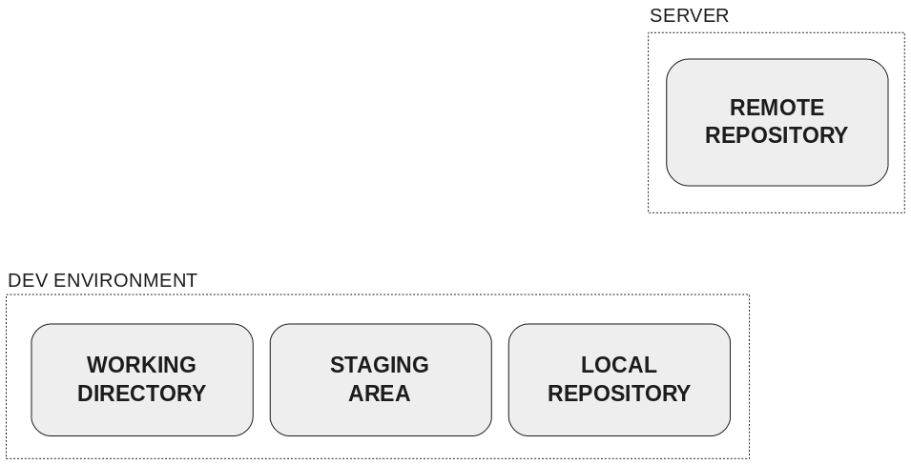
Git what?
Distributed Version Control Software
Distributed
Version history is stored across many devices
Version Control
Tracks different versions of a project

Slide 3
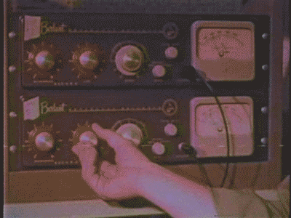
Git Config
Two configs: global and local
Manage Identity
$ git config --global user.name=“Git Guru”
$ git config --global user.email=“guru@git-scm.com”
Configure how line endings are handled
$ git config --global core.autocrlf true
Set up aliases
$ git config --global alias.psuh push
Manage which text editor you want to use
$ git config --global core.editor vim

Slide 4
Setting up a repository
Repository:
a central location in which data is stored and managed.
$ git init
Creates a .git folder in the current directory
.git folder contains information Git uses
$ git init --bare
Creates a “bare” repository
This repository can be used as a “remote”
For most cases, GitHub, BitBucket, GitLab, etc. does this for you
Remote:
A repository that exists outside of your development environment

Slide 5

Remotes
$ git remote list
Lists all remotes for your repository
$ git remote add name url
Adds a reference to a new remote
Multiple remotes is how “Forks” work
First clone the repository you want to fork
Create a bare repo where you want to host the fork
Add the bare repo as a new remote
Push to the new remote
Check out git spooning https://bitbucket.org/spooning/

Slide 6

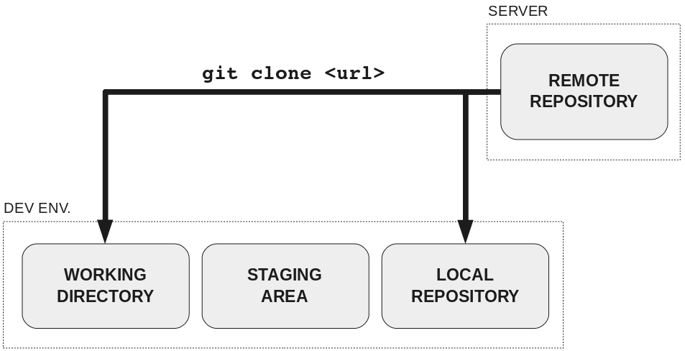
Git Clone
$ git clone https://your.repo.url.com/repo
Creates a local copy of the remote repository
Stores a remote in your local repo that points to that url
$ git clone you@your.repo.url.com:repo.git
Does the same thing, but does so over SSH, configuring Git to use your account

Slide 7
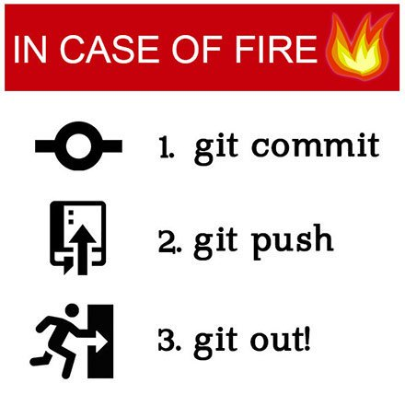
Standard Workflow

Slide 8
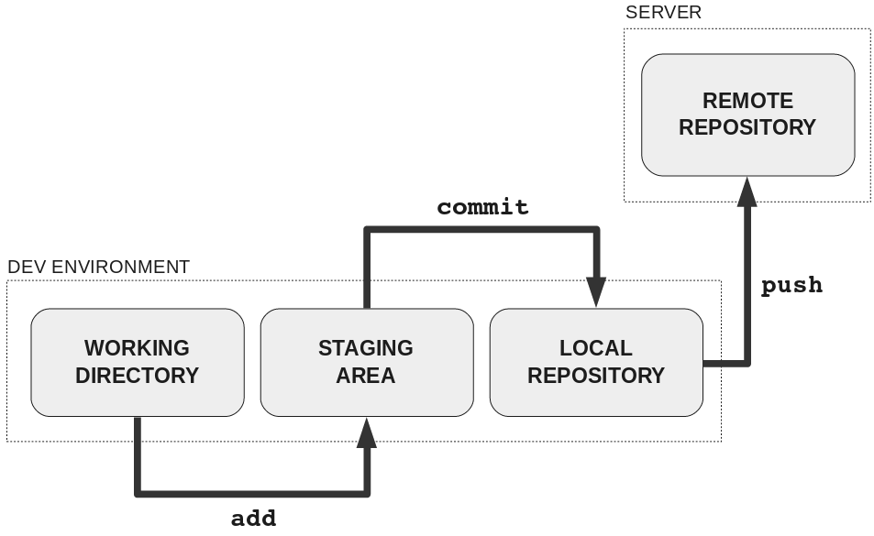
Making and Staging changes
Changes are not automatically saved
Process to save changes to the remote repository

Slide 9
Add
$ git add filename
Supports wildcards
$git add *.java
$ git add -A
Adds all of the tracked files in the current working directory
$ git status
Shows checked and unchecked files

Slide 10
Commit
$git commit -m “Meaningful commit message”
Creates a snapshot of the current repository
Stored as line differences from previous commit
Takes effort to change, commit wisely

Slide 11

What is a commit?
Often Visualized with Directed Graphs
Contains information about
Who made the changes
What changes where made
When the changes were commit
The previous commit(s) in the graph
A message about the changes
Commit SHA, a unique ID
$ git log
Shows the commit history
Git keeps track of history on a branch by branch basis
Your local history may differ from the history on a remote

Slide 12
More about Commits
HEAD
Often called a “pointer” to a commit
Refers to the most recent commit in the current branch
Refnames
You can refer to commits relatively to other commits such as HEAD
HEAD~1 means the previous commit
HEAD~2 means the commit before the previous commit
There are a lot more ways to navigate the structure, learn here:
https://git-scm.com/book/en/v2/Git-Tools-Revision-Selection
Sha1
Every commit gets a hash value: ec392edb07881315ee6d73edb055da49ab671d30
This can be shortened to the first 7 numbers: ec392ed

Slide 13
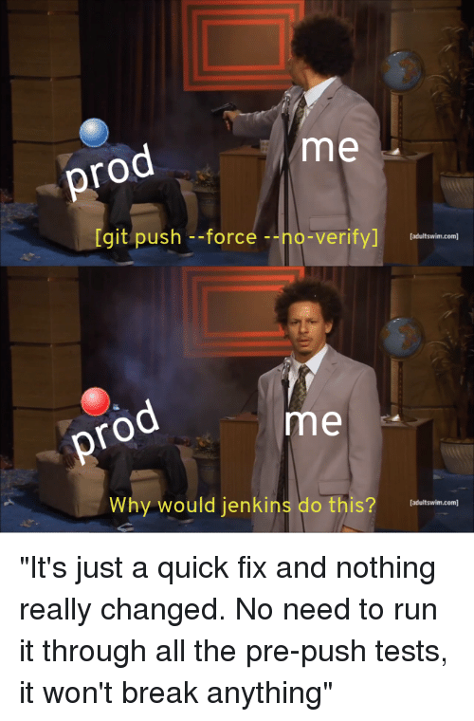

Push
$ git push origin master
Sends the changes from one branch to the corresponding remote branch
If the remote’s history differs from the local history, the push may fail
$ git push -u remote branchname
Tells git to default to a specific remote
$ git push -f

Slide 14
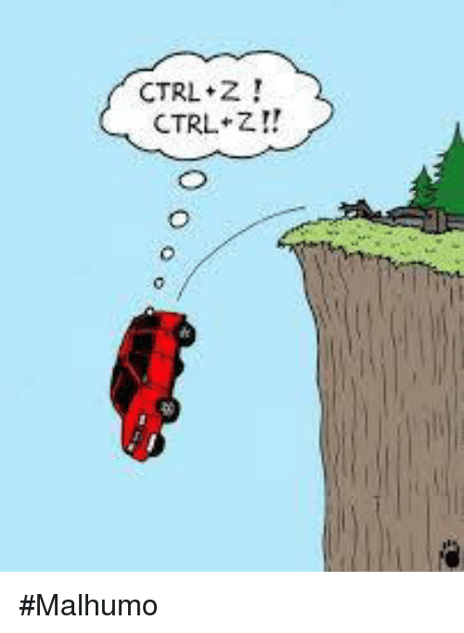
Commitment Issues: How to Undo
$ git reset --hard 4d4f80b
Sets the local repository back to 4d4f80b
Working directory is discarded
$ git reset --hard HEAD~2
Undoes 2 commits
$ git revert 4d4f80b
Creates a NEW commit
Changes made after 4d4f80b are undone

Slide 15
Standard Workflow Review

Slide 16
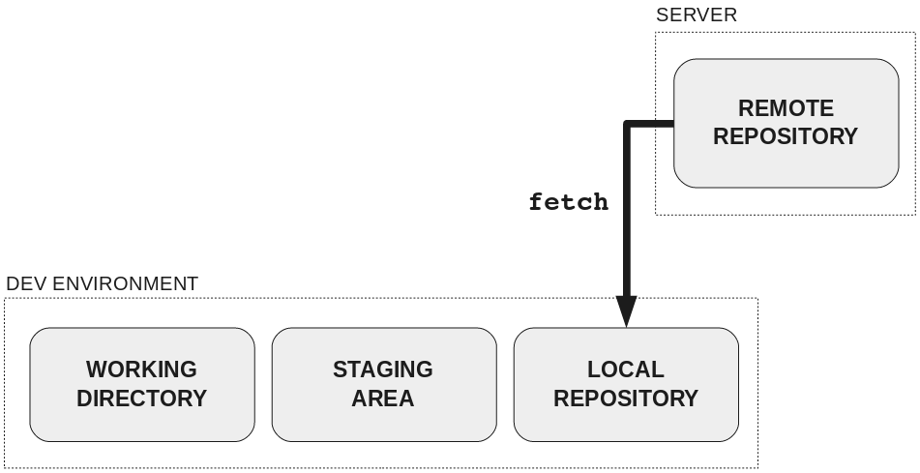

Fetch
$ git fetch [remote]
Retrieves changes made on the remote repository

Slide 17
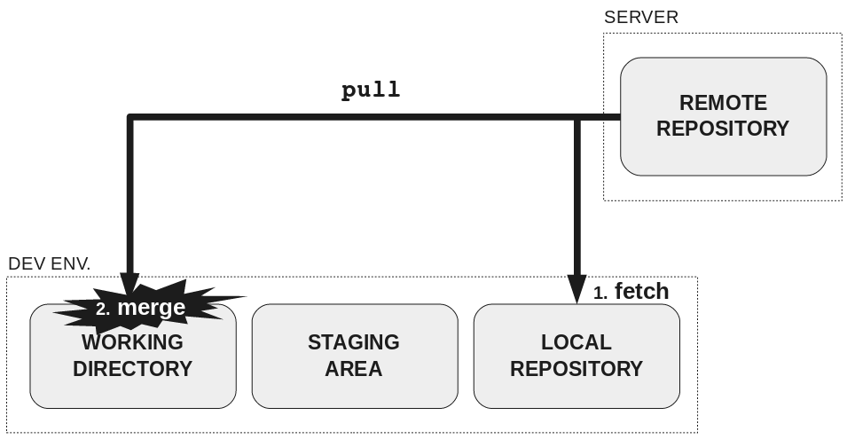
Pull
$ git pull [remote]
Functionally equivalent to
$ git fetch [remote]
$ git merge
$ git pull –rebase [remote]
replace merge with rebase

Slide 18

Ignoring Files
Some files you don’t want to commit to the remote
Create a text file titled .gitignore
.gitignore applies to the directory and its children
Each line is a pattern of which files to ignore
Lines that start with # are comments
Must include the trailing / for directories
*.o
[Bb]uild/
Some IDEs will autogenerate a .gitignore appropriate for your project

Slide 19
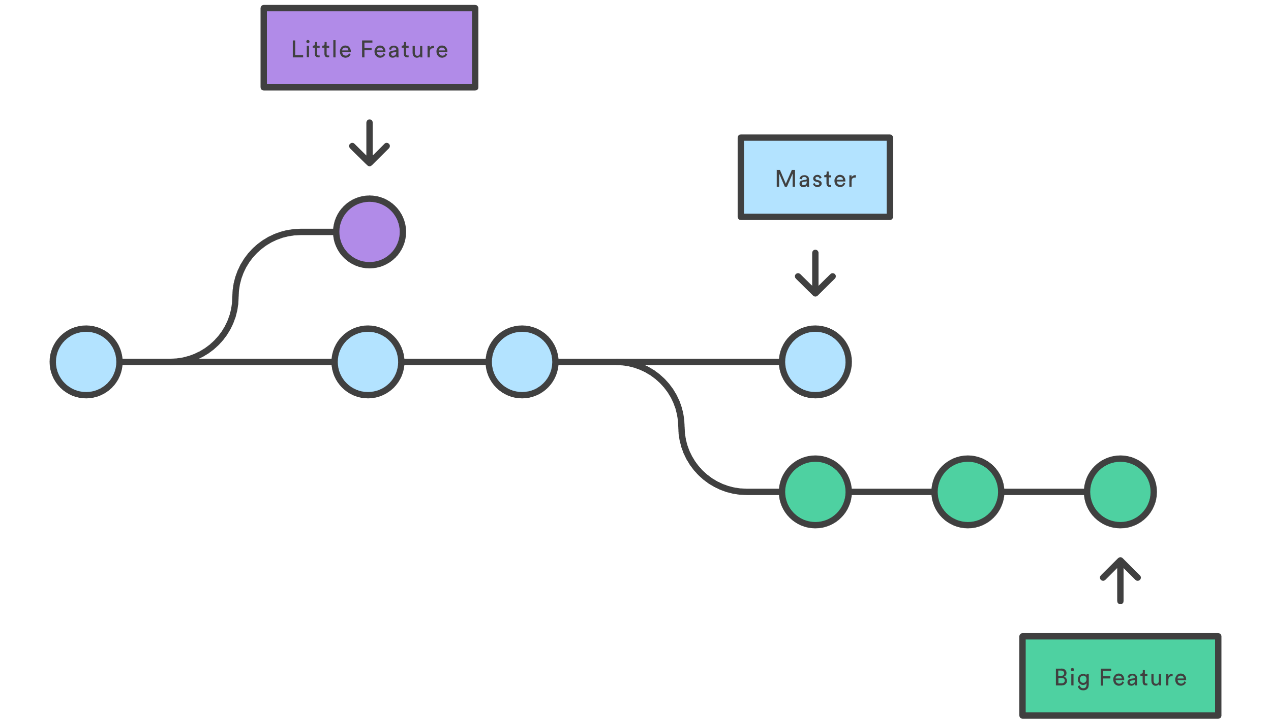
Branching
Some changes could break other features
Create branches to commit changes without impacting the master branch
$ git branch feature
Creates a local branch feature
$ git checkout feature
Changes HEAD to point to feature
Any new commits end up on this branch
Pushing from a new local branch creates a new branch on the remote
$ git checkout –b feature
Creates a new branch and checks it out

Slide 20
Checkout
$ git checkout branchname
Used to swap between branches
$ git checkout ec392ed
Moves HEAD to the commit ec392ed
This creates a DETACHED HEAD
Any commits you make off of this branch will be garbage collected unless you create a new branch with
$ git checkout -b newBranch
$ git checkout -
Checks out the last branch you were on
$ git checkout master myFile.java
Checks out only myFile.java from the master branch

Slide 21
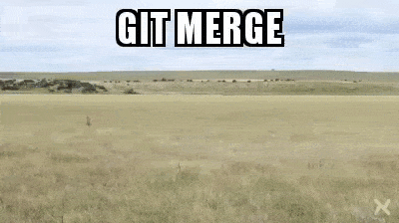
Merging
Merge changes from one branch into another
$ git checkout master
$ git merge feature
Merges the changes on feature into master and creates a new commit
For the most part, merging is pretty painless
Merge conflicts can arise

Slide 22
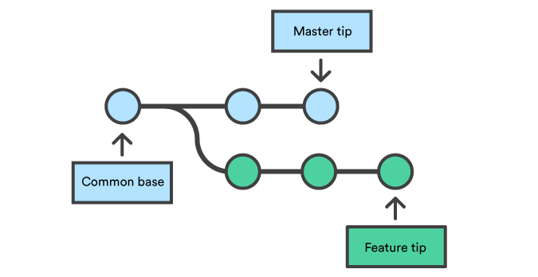
Merging Visualized

Slide 23
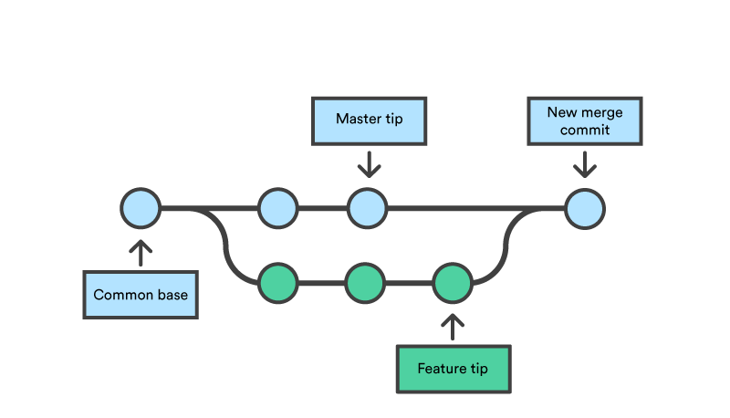
Merging Visualized

Slide 24

Dealing with Merge Conflicts
Resolve conflicts in your files
$ git add -A
$ git merge --continue
Alternatives:
$ git merge --strategy=ours
Keeps the changes on the checked out branch, ignoring changes on the merging branch
$ git merge --strategy=theirs
Keeps the changes from the merging branch, discarding our changes when necessary
Check out more strategy choices here:
https://git-scm.com/docs/git-merge#_merge_strategies
$ git merge --abort
Basically giving up on life
and trying something else

Slide 25
Other cool commands
$ git commit --amend
Modifies the last commit
Any staged changes will be applied
$ git stash
Stores moves any unstaged changes to a hidden stash
Allows you to checkout another branch without committing or losing work
$ git stash pop
Recovers previously stashed work
$ git rm filename
Stages a file for deletion in the next commit
$ git diff
Shows the differences between the working directory and the local repository

Slide 26
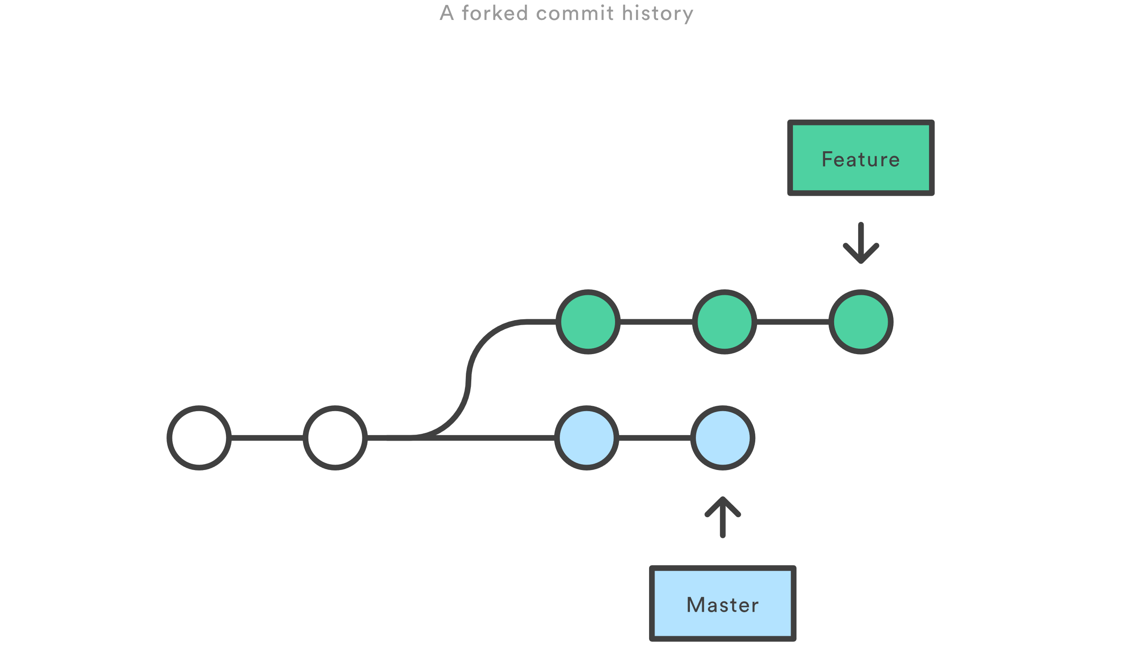
Rebasing
Literally changing the base commit of a branch to the new tip of a branch
Useful for handling merge conflicts before they become a bigger issue

Slide 27
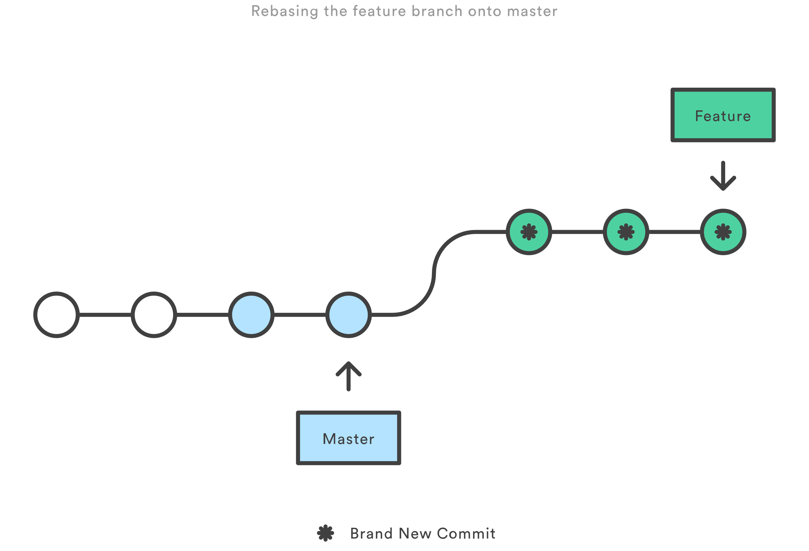
Rebasing
Literally changing the base commit of a branch to the new tip of a branch
Useful for handling merge conflicts before they become a bigger issue

Slide 28
How to Rebase
Rebase replays the commits from the checked out branch onto the rebasing branch
$ git checkout feature
$ git rebase master
One by one the commits in feature will be reintroduced to the branch
This will present merge conflicts as they arise and let you logically walk through them
$ git rebase master --strategy=ours
This will take the work that is in master and discard any of the work in feature that conflicts with master. Use theirs to keep the work in feature.

Slide 29
Rebase Interactive
$ git rebase -i a313beb
Rebases in interactive mode
Opens your text editor and lets you pick what to do for each commit
Powerful tool, but ripe for abuse
Literally lets you rewrite history
Common Use Cases:
Removing commits
Squashing commits
Might require a force push once complete

Slide 30

Cherry Pick
$ git cherry-pick a313beb
Takes the changes from commit a313beb on another branch and applies those changes to the current branch as a new commit
Allows you to:
incorporate changes from a branch one at a time to prevent merge conflicts
recover work from a corrupted branch
Test code from a feature branch in a sandbox branch

Slide 31

Next Steps
Git Hooks
Pull Requests/Merge Requests
Repository Configuration
Protected Branches
Tags
Dry Runs
Try a command to see its affects without risking
PRACTICE!

Slide 32
Useful Links
Git Documentation:
https://git-scm.com/docs
Specific Git Tutorials:
https://www.atlassian.com/git/tutorials
If Command Lines aren’t your thing:
https://www.gitkraken.com/
How to Write a Git Commit Message
https://chris.beams.io/posts/git-commit/
Funny Git Commit Message
https://whatthecommit.com
Demo Walkthrough:
www.github.com/smlevorse/GitTechTalk

